Slide 1
AWS Honolulu User Group
2018-03-01 – 2nd Meetup

Slide 2
Agenda
Meetup Overview
Deploy a Blog on AWS with ElasticBeanstalk (by Moe Sy)
Deploy a Serverless Slack registration app (by Pipe)
Domain registration and DNS settings on Route 53
Closing Notes

Slide 3












Traditional Web Architecture
WEB SERVER
HTTP Server
DB SERVER
Data Base Access
Http Handling
HTTP Request
Routing
Authentication
Request Handling
View Engine
DB Access
HTTP Response

Slide 4

Scaled Web Architecture
WEB SERVER
HTTP Server
- Routing
- Authentication
- Request Handling
- View Engine
LOAD BALANCER
WEB SERVER
DB SERVER
HTTP Server
Data Base Access
- Routing
- Authentication
- Request Handling
- View Engine
WEB SERVER
HTTP Server
- Routing
- Authentication
- Request Handling
- View Engine

Slide 5






Serverless Architecture
AWS Cloud
Client downloads html, js, css, img, etc. from an S3 Hosting bucket
S3 Hosting bucket
CloudWatch
Write logs to CloudWatch
Maps and parses HTTP request to a function
Client calls a server-less Restful API
Stores member data in DB
API Gateway
Maps and parses function result to HTTP Response
Lambda
DynamoDB
Sends slack invite
/polls
/polls/{poll_id} /polls/{poll_id}/votes
/polls/{poll_id}/results

Slide 6
Announcements
March 3rd Open Data Day by Code for Hawaii
March 8th and 9th - AT&T Hackathon (AWS Sumerian?)
Next AWS Meetup???

Slide 7
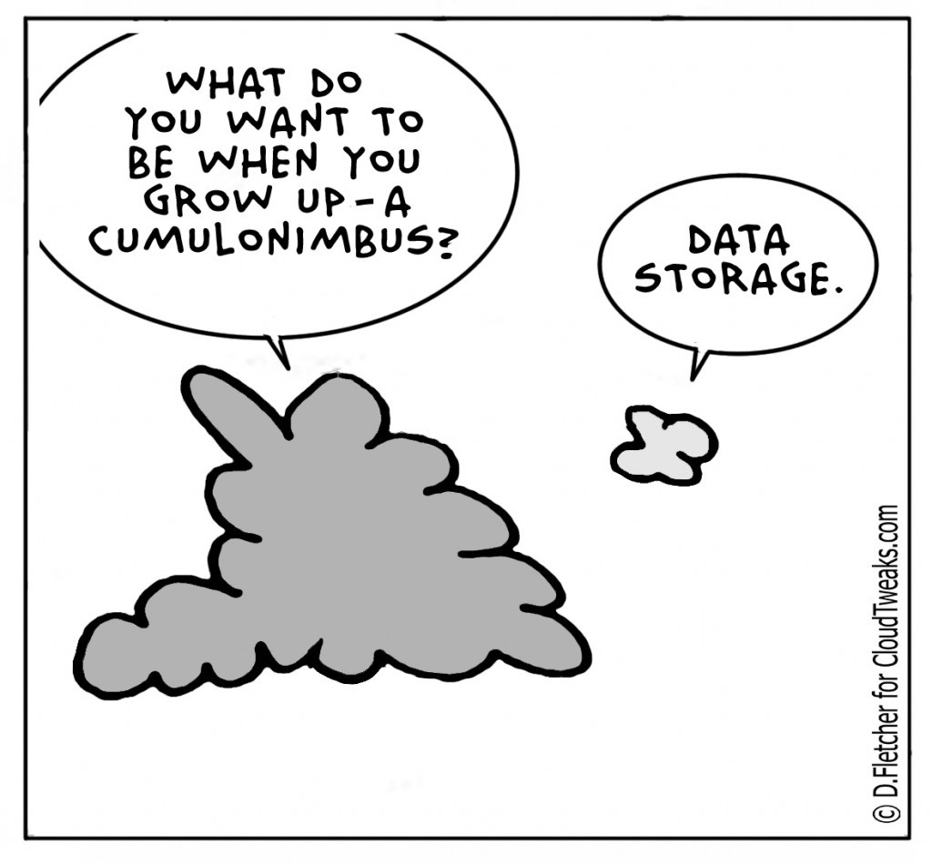
Questions?

